Slide 1


Andrew Aquino
Dan Bruce
Jason Kim
Blake Lingenau
Jeremy Simon

Slide 2
What is Menuoso?
Notes:
Blake

Slide 3
What is Menuoso?
Menu + Virtuoso
Menuoso is an open-source digital menu system utilizing off-the-shelf and inexpensive hardware, designed for counter-service restaurants.
Notes:
Blake

Slide 4
Team 2
Who are we?
Andrew Aquino Front-end
Dan Bruce Hardware
Jason Kim UI/UX
Blake Lingenau Back-end
Jeremy Simon Back-end/Front-end

Slide 5
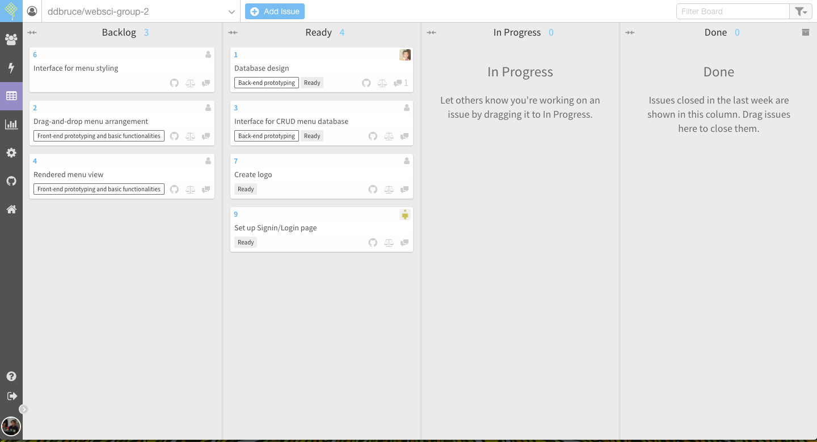

WORKFLOW
Agile development with a Kanban methodology on Waffle.io + weekly meetings
Notes:
Blake
Project methodology

Slide 6
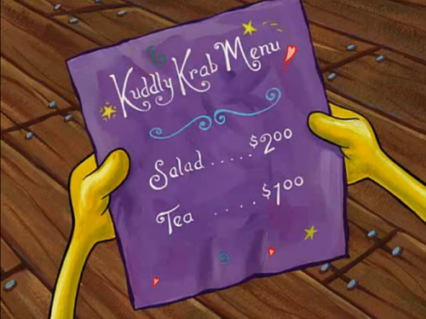
PROBLEM
Paper menus are difficult to change.
Existing solutions are too expensive.
Alternative solutions like PowerPoint do not look nice.

Slide 7
USERS/STAKEHOLDERS
Managers
Small-business owner or leader of cafe or fast-food restaurant.
Takes ownership of the created menus.
Edit-Permission-Users
Given permission by the manager to access and edit a menu within the interface
Permissions are given on a menu-by-menu basis by a manager.
Customers
Patrons of the restaurant who will view the menu.
Value generated through clear information, e.g. vegan, vegetarian, gluten-free options.

Slide 8
Implementation

Slide 9

Stack
Notes:
Andrew
MongoDB, Express, Angular2, Node
Wholly JavaScript, lots of abstractions, lots of StackOverflow references for inexplicable errors

Slide 10
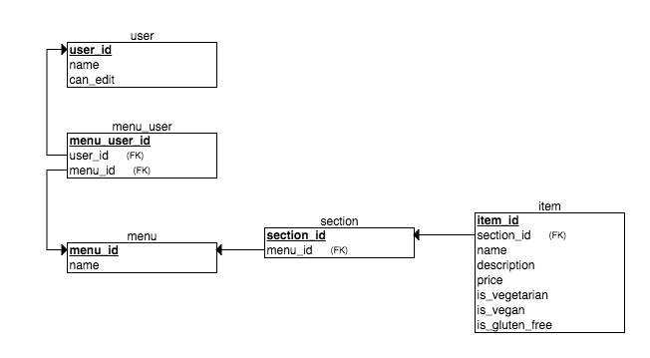
DATABASE DESIGN
Users, Menus, Sections, Items
To be added soon:
Allergens
Section order
Item order
Active menu status
Made with ERDPlus
Notes:
Andrew
Menus contain child references to Sections;
Sections contain child references to Items
->Blake, implementation
MongoDB doesn’t have joins or foreign keys, but a populate() method that can fill query results with info from other collections

Slide 11
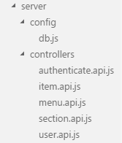
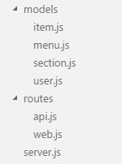
BACKEND DESIGN
Modular Design
Notes:
Blake
Allows for a separation of duties in the code
Increases readability
Everyone knows what every file is for

Slide 12
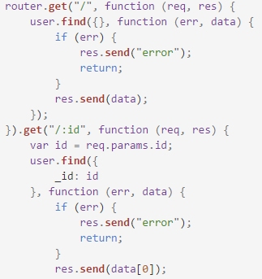
BACKEND IMPLEMENTATION
CRUD interaction with the database
Notes:
Blake
CRUD implementation allows for the addition, removal, and updating of data in our database

Slide 13
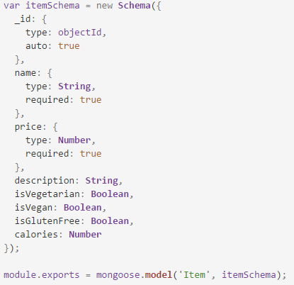
DATABASE INTERACTION
Mongoose
Notes:
Blake
Mongoose was used as the tool to interact with our Mongo database
Created schemas for each database object that defined their structure

Slide 14
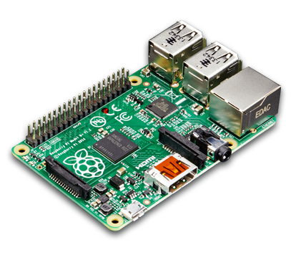

Hardware
+
Notes:
Dan

Slide 15
HARDWARE COSTS
Raspberry Pis | ~$50 apiece
Networking Equipment | ~$50 Minimal if the business already has a network
Television | As much or as little as the owner wants
Notes:
Dan

Slide 16
HARDWARE FEATURES
One-command setup
Master or slave
Existing network (with hostname) or new network
Auto-reboot after power loss
Solid-state construction
Notes:
Dan

Slide 17
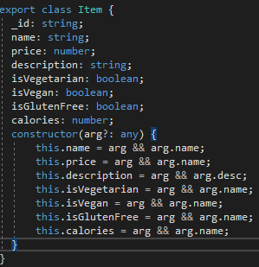
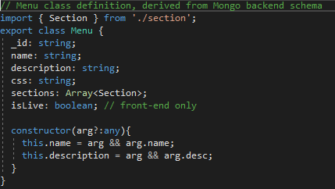
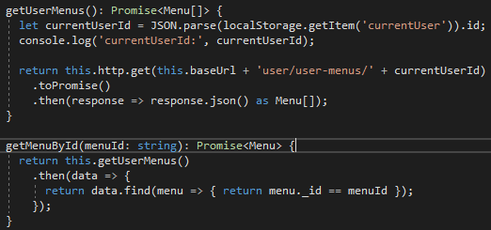
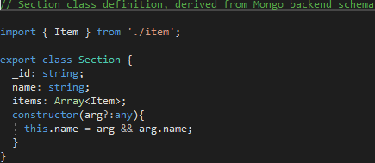
FRONT-END DESIGN
Designed to mirror backend design
Angular Menu Service for menu
functionality
Notes:
Jeremy
TypeScript objects get created whenever the database is queried
Andrew
MenuService communicates between frontend/backend

Slide 18


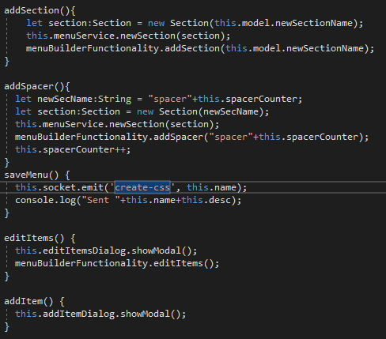
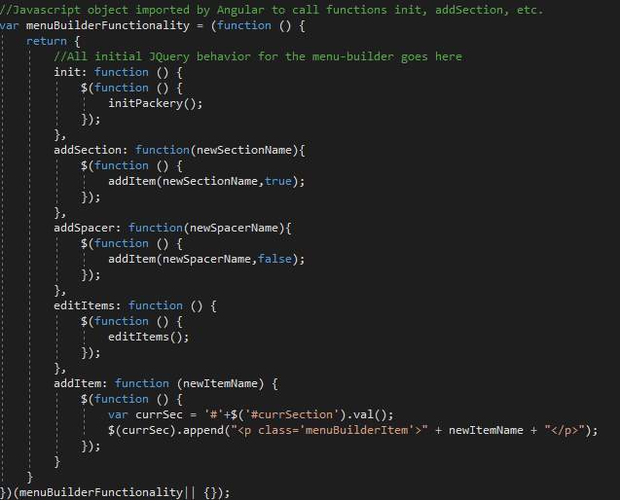
Menu Builder Implementation
Notes:
Jeremy

Slide 19
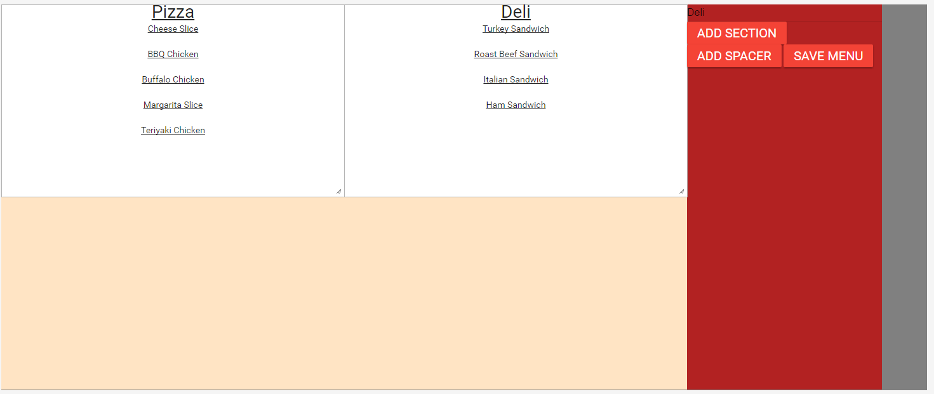
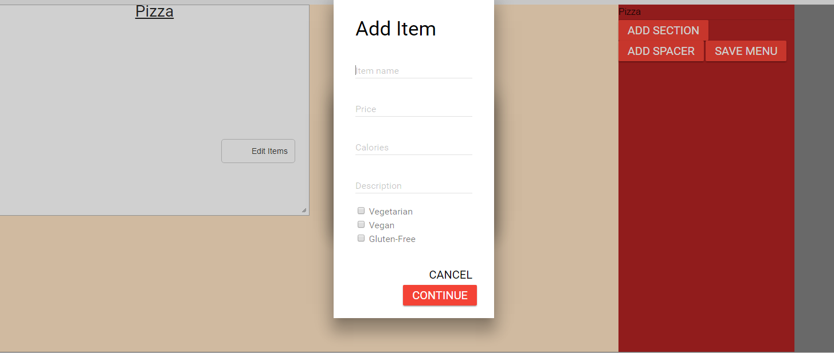
Menu Builder Implementation
Notes:
Jeremy

Slide 20
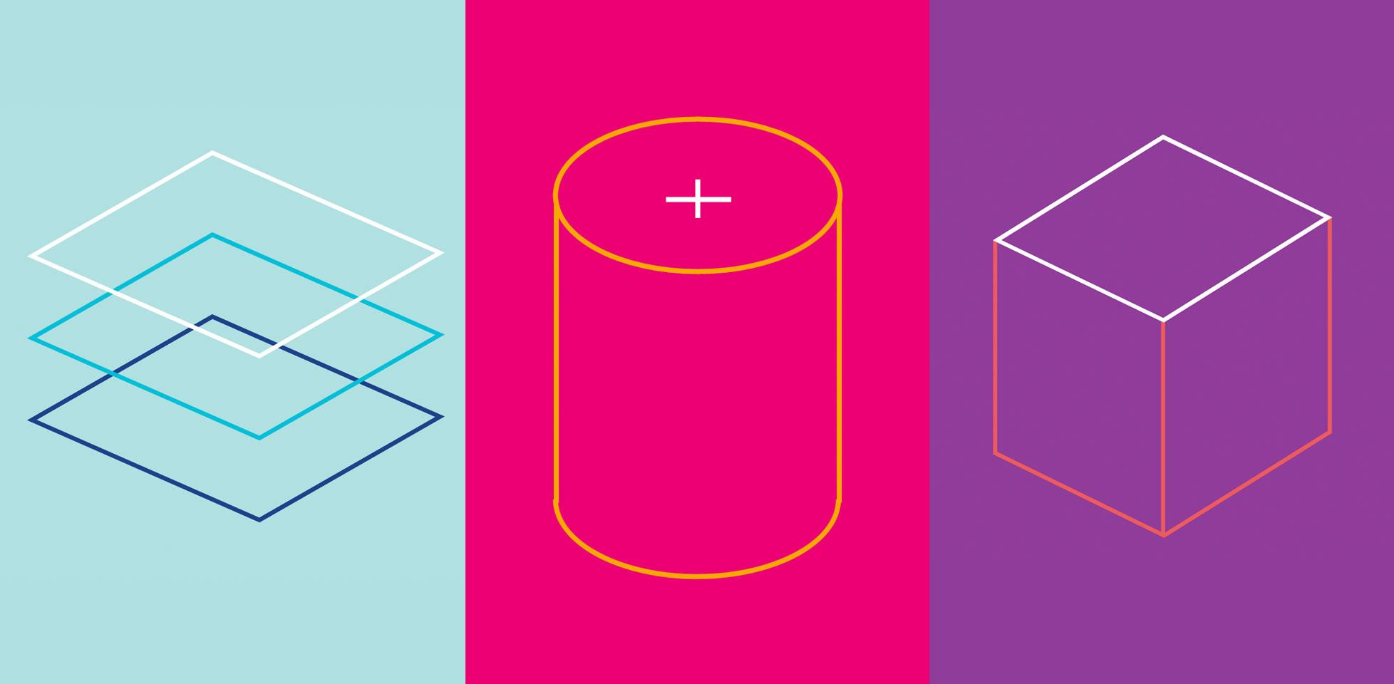
Material Design Lite
Notes:
Jason
Material Design for the overall look and feel
Dialogs, rippling buttons

Slide 21

BRANDING

Slide 22
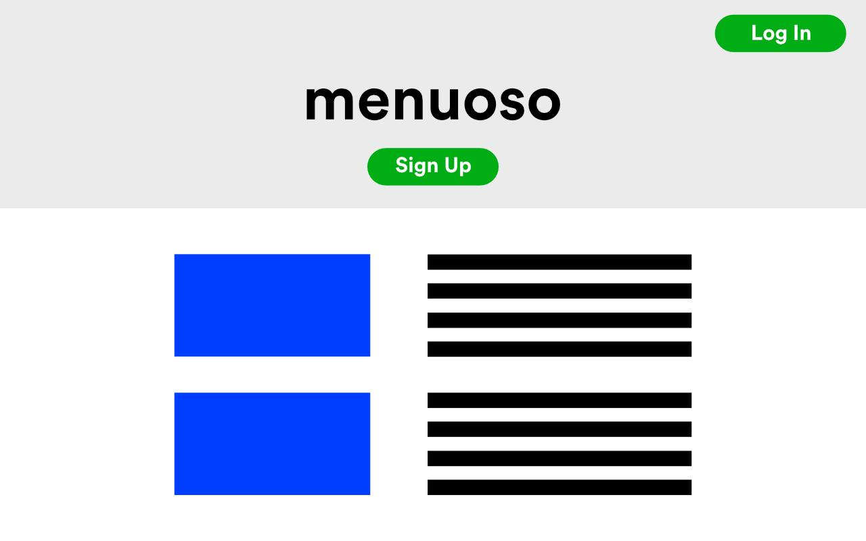
Notes:
Quick run through of the old mockups.

Slide 23
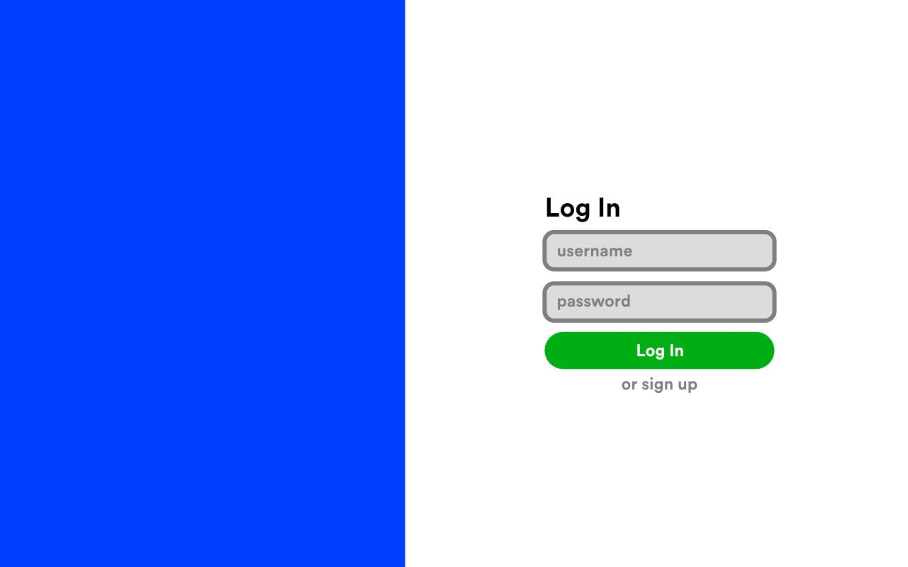

Slide 24
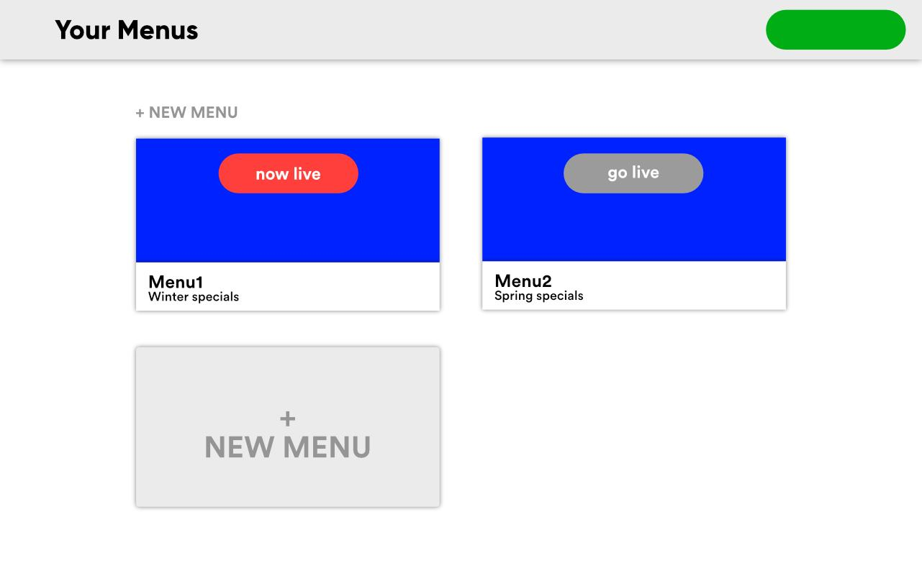

Slide 25
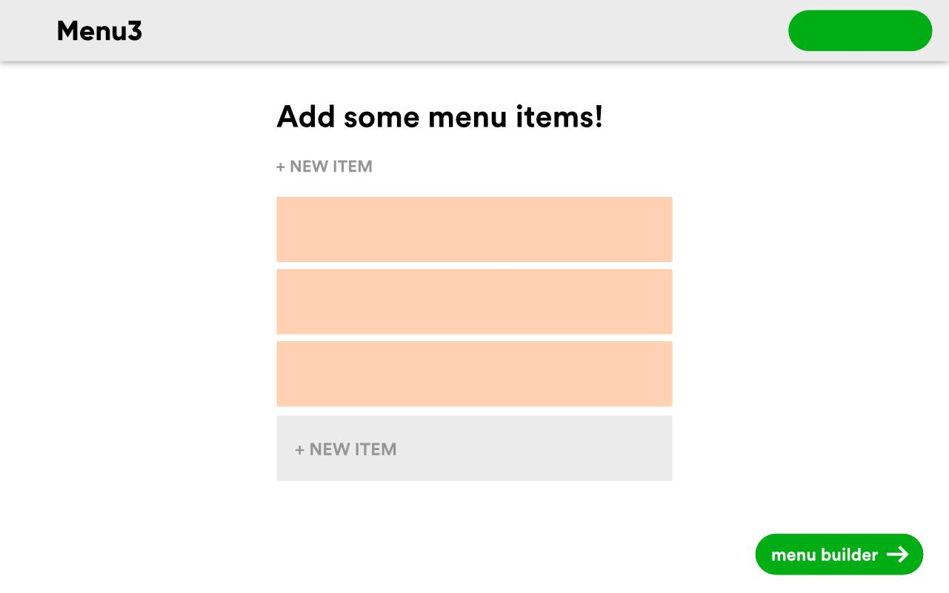

Slide 26
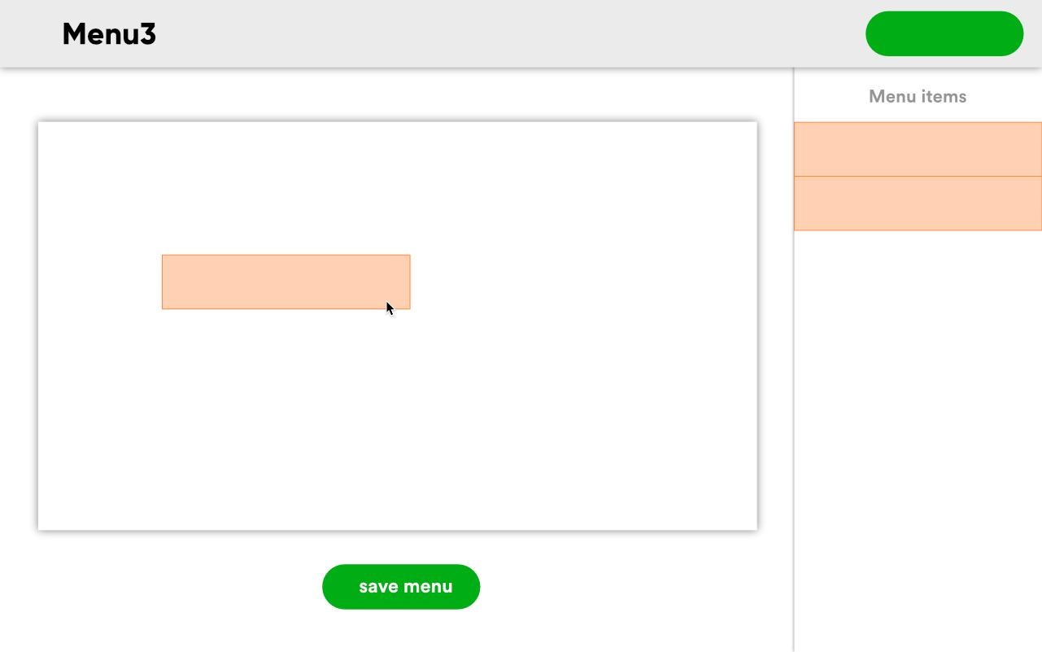

Slide 27
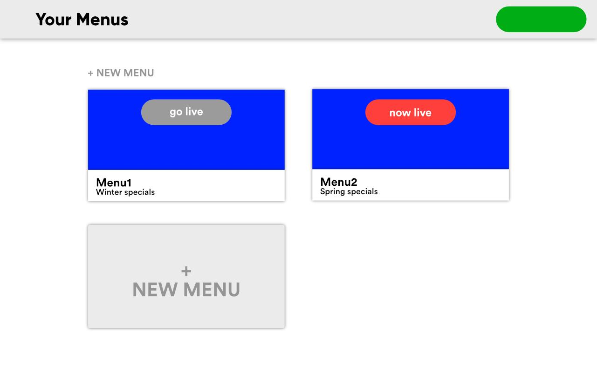

Slide 28
Progress to date
Menu builder for arrangement
Rendered menu view

Slide 29
Demonstration
Notes:
Doing most of the demonstration.
Spend alot of time talking about the hardware i hope.

Slide 30
Future Considerations
Expand the CSS options for users in their menus.
User testing on JQuery editor
Deployable servers to hold menus across more than one raspberry pi.
Live updating menus

Slide 31
QUESTIONS?

